Slide 1
Building an evidence-based holistic approach for advancing integrated employment
RRTC on Advancing Employment for Individuals with Intellectual/ Developmental Disabilities
September 20, 2017

Slide 2
Acknowledgements
The work of this Center was developed under a grant from the National Institute on Disability, Independent Living, and Rehabilitation Research (NIDILRR grant#90RT5028) . NIDILRR is a Center within the Administration for Community Living (ACL), Department of Health and Human Services (HHS). The contents of this presentation do not necessarily represent the policy of NIDILRR, ACL, HHS, and you should not assume endorsement by the Federal Government.

Slide 3
Project Partners

Slide 4
Memorable Quote
“Employment is a way for people with disabilities to give to the community and see what they have to offer.
We’re givers, not just takers.”
(Max Barrows, SABE)

Slide 5
Setting the stage
Individuals want to work.
Well-established technology exists for employment support.
State and federal policy emphasize work as a priority for public supports.
Only 14% of individuals served by state IDD agencies work in individual integrated jobs.*
*National Core Indicators, 2015-2016

Slide 6
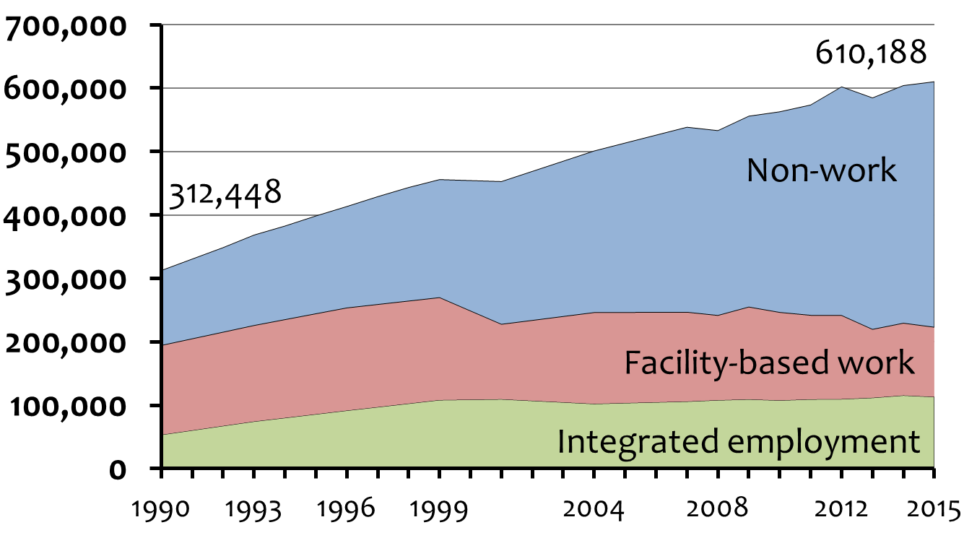
Number in Employment and Day Services
Source: ICI National Survey of State IDD Agency Day and Employment Services

Slide 7
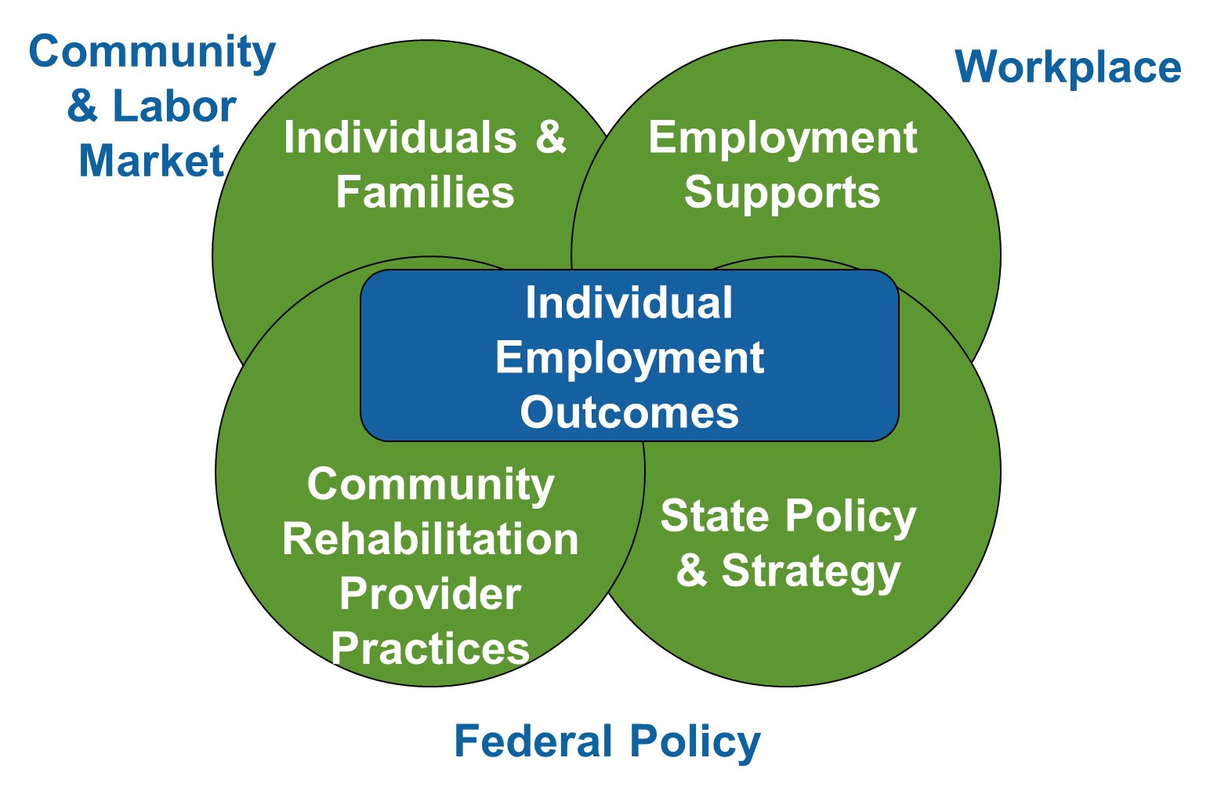
Holistic Perspective

Slide 8
Examples of stakeholder engagement
Dissemination partners
Project advisors
Member checking
Bi-monthly 44 webinar series (400+/webinar)
Social media presence
State of the Science process
Sponsored presentation/feedback sessions
IdeaScale
Invited meeting

Slide 9
Strand 1: Individual and family engagement Goal
Develop and test an information, outreach, and support framework for individuals and families.

Slide 10
What we know from past research
Young adults expect to work as adults.
Working-age adults want to work.
Families are influential in the decision-making process, and parent expectation is a strong predictor for employment.
Families lack knowledge.
School-based staff, employment consultants, and provider culture influence employment decisions.

Slide 11
Research questions
What strategies have been successful in engaging families in employment?
What information and support approaches are useful/effective for families?
How can we share information in a way that is most useful for families?

Slide 12
Method
Scoping literature review
In-person and online forums and focus groups
Family engagement intervention (in process)

Slide 13
Findings: Scoping literature review Themes
Family modeling shapes employment experiences.
Engaging families supports a focus on employment.
Family/individual demographics are related to employment.

Slide 14
Findings: Scoping literature review Strategies
Training
Explore, Prepare, Act
FEAT
Online resources
Let’s Get to Work (WI)
Planning tools
The Arc’s Build Your Plan
LifeCourse tools
Peer-to-peer outreach
Social media

Slide 15
Findings: Online focus groups and forums
Confusing guidance and low systems expectations.
Navigation is hard: lack of alignments & discontinuity.
System lacks capacity.
More success when relying on self and family.

Slide 16
Intervention (ongoing)
Goal is 100 families (young adults ages 14-24).
Engagement strategy based on findings from literature review, forums, and focus groups.
4-pronged approach:
Arc Center for Future Planning Tool
Private Facebook group (discussion, reminders)
Positive messages about employment
Information and referral

Slide 17
Strand 2: Employment support practices Goal
Assess a cost-effective strategy for improving the implementation of employment support practices. This will be done through integration of online training, data-based performance feedback, and facilitated peer supports.

Slide 18
What we know from past research
Extensive literature on effective support practices.
35,000 employment consultants nationally (estimated).
Limited implementation of best practices.
Training + mentoring improved number of placements, wages, time to placement.

Slide 19
Research questions
What strategies do effective employment consultants use?
How do consultants make decisions about which support strategies to use for each individual?
What is the effectiveness of data-based feedback, online training, and a community of practice?

Slide 20
Methods
Qualitative interviews with employment consultants, supervisors, families, and individuals
Employment consultant intervention (in process)

Slide 21
Findings: Interviews
Build trust with the job seeker and family.
Find out what the job seeker wants out of life, and seek employment that fits their vision.
Make decisions about support strategies based on individual preferences and support needs.
Be creative in the search. Look for tasks and opportunities, not just job openings.
Network with employers & community businesses.
Involve the job seeker in every step of the process.

Slide 22
Comprehensive Model of Employment Support

Slide 23
Intervention: Employment supports (ongoing)
167 participants, 85 CRPs, 30 states
Baseline and quarterly surveys
Intervention components
Daily activity survey by smartphone
Monthly community of practice & goal
Monthly performance feedback
College of Employment Services (15 lessons)
Mentoring

Slide 24
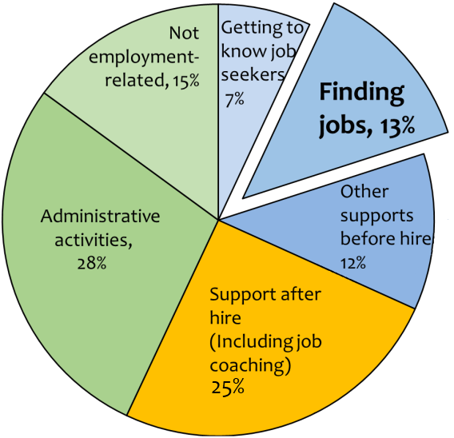
Preliminary findings: Employment consultant time distribution

Slide 25
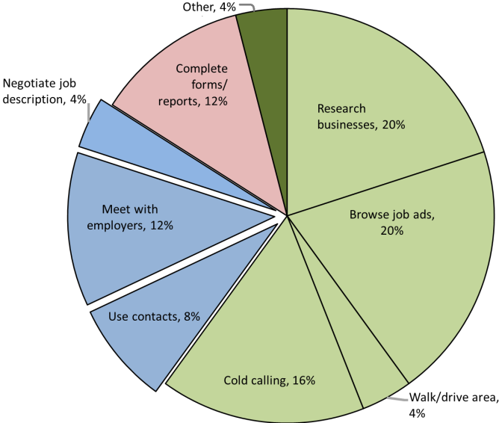
Preliminary findings: Time spent on finding jobs

Slide 26
Strand 3: Community Rehabilitation Providers (CRPs) Goal
Develop a strategy for supporting CRPs to rebalance resources to emphasize individual integrated employment.

Slide 27
What we know from past research
Only 9% CRP staff dedicated to employment.
89% CRPs said facility-based programs needed.
Direct support staff experience confusion about roles; feel unprepared.
Organizational transformation requires alignment of goals, communication, resources, rapid job placement, community partnerships, wrap-around supports.
Change driven internally, not by state goals and policy.

Slide 28
Research questions
What are the characteristics of CRPs that have transformed services to emphasize high-quality integrated employment?
What organizational, state, and community factors influence organizational transformation?
What is the impact of a facilitated peer network of providers on rebalancing of resources and employment outcomes?

Slide 29
Methods
Delphi panel of experts to confirm and augment a framework for organizational change as identified through past research.
Case studies of CRPs that have undergone successful organizational transformation.
Provider intervention (in process) that tests a strategy that includes use of the Agency Change Toolkit.

Slide 30
Findings: Delphi panel Organizational factors ranked by perceived importance
Clear and consistent goals
Agency culture that values inclusion*
Active, person-centered job placement process (one person at a time)
Strong internal & external communications
Reallocated and restructured resources
*New element

Slide 31
Findings: Delphi panel (continued)
Ongoing investment in staff learning*
Focus on customer engagement/feedback*
Effective performance measurement, quality assurance, & program oversight*
Holistic approach to supports
Multiple & diverse community partnerships
*New element

Slide 32
Findings: Case studies
Arc of Westchester (NYC metro)
At Work (Seattle metro)
Work, Inc (Boston metro and Cape Cod)
Penn-Mar Human Services (rural Pennsylvania)
The Delphi Panel findings confirmed and refined the structure, while the case studies provided on-the-ground examples, strategies, and depth to the 10 organizational factors.

Slide 33
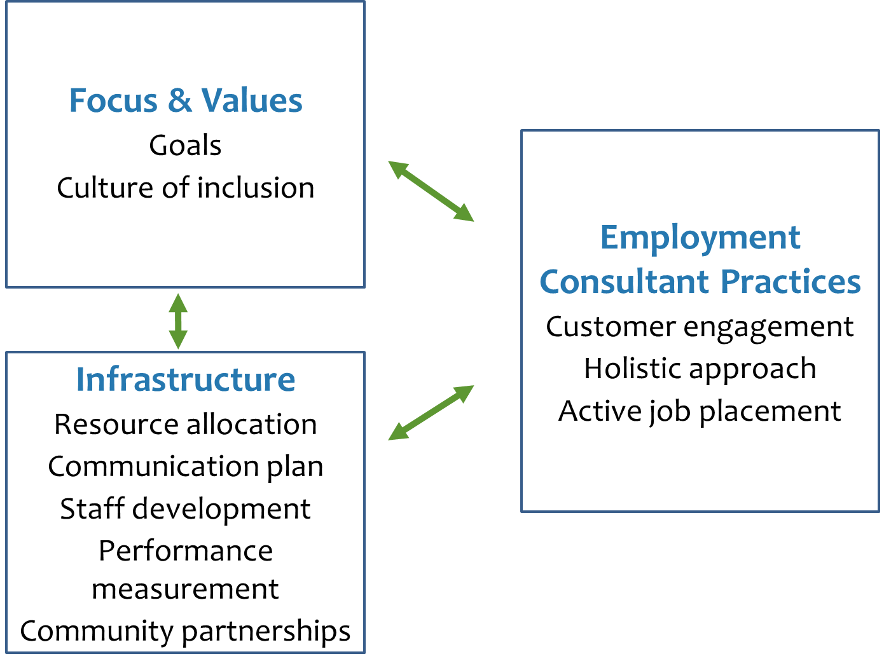
Organizational Transformation

Slide 34
Intervention (ongoing)
12 Arc chapters over two years, selected through RFP process
Intervention components
Agency Change Toolkit
Guided self-assessment
Customized organizational action plan
Monthly expert technical assistance
Monthly topical webinars
Leadership summit in Washington, DC

Slide 35
Agency Change Toolkit
Online tool organized by 10 elements for organizational transformation.
Guided by Delphi panel and case study research results.
Provides self-assessment, promising practices, concrete tools, and templates for organizations at multiple stages of transformation process.
Being piloted with Arc providers.

Slide 36
Strand 4: Aligning policy and practice across state agencies Goal
Analyze state employment systems policies and practices and their relationship to individual outcomes at a multi-agency level.
Define policies and practices of high-performing state employment systems.

Slide 37
What we know from past research
State IDD agency outcomes vary widely & agencies have inconsistent/competing priorities.
Non-work services are growing.
In 2015-2016, only 14% of individuals served by state IDD agencies worked in individual integrated jobs.
In FY2015, only 13% of state IDD funding for day services was spent on integrated employment.
Interagency coordination of services is challenging.

Slide 38
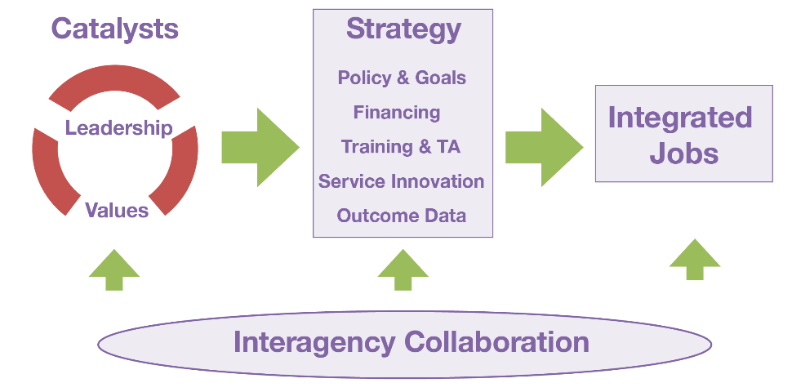
What we know from past research Higher-Performing States Model
Hall et al., 2007
Notes:
38

Slide 39
Research questions
What are the characteristics of higher-performing employment systems?
What is the relationship between systems’ characteristics and employment outcomes?

Slide 40
Methods
Secondary data analysis to determine higher performing state systems
Composite indicator (IDD, VR, Education)
Case studies of higher-performing state systems
Topical state policy analyses that describe challenges and strategies
Prevocational services
Support coordination/case management
The employment process & braiding services

Slide 41
Findings: Composite indicator rankings
 | Rank | Overall CI Score | IDD Score | VR Score | Education Score
MD | 1 | 47.38 | 21.60 | 15.22 | 10.56
NH | 2 | 47.26 | 22.76 | 9.63 | 14.86
VT | 3 | 46.88 | 22.76 | 13.75 | 10.37
OR | 4 | 44.77 | 21.60 | 12.81 | 10.35
WA | 5 | 44.26 | 22.84 | 10.87 | 10.56
IA | 6 | 42.48 | 15.42 | 13.78 | 13.28
OK | 7 | 41.98 | 21.67 | 12.79 | 7.52
SD | 8 | 40.51 | 14.33 | 14.72 | 11.46
CO | 9 | 39.78 | 14.47 | 13.92 | 11.39
DE | 10 | 39.60 | 19.20 | 14.32 | 6.08

Slide 42
Findings: Case study research in MD
Success over the long term depends on a cadre of stakeholders.
Leadership is most effective when distributed across multiple levels of responsibility.
Consistent allocation of funds for long-term services for youth exiting schools is critical. Cements expectation for collaboration between school and adult service systems.

Slide 43
Findings: State-level policy analyses
Leadership through setting values, setting direction, and creating the infrastructure for change.
Support coordination/case management to increase prioritization of employment.
Managing the employment process, including sequencing funding with VR (in process).

Slide 44
www.ThinkWork.org/rrtc
john.butterworth@umb.edu
cindy.thomas@umb.edu

